Slide 1
Mount Auburn Professional Services
Practice Improvement Project
Mount Auburn Medical Associates
Appointment Referral Management
“Closing The Loop”
Colon Cancer Screening
December 4, 2015

Slide 2
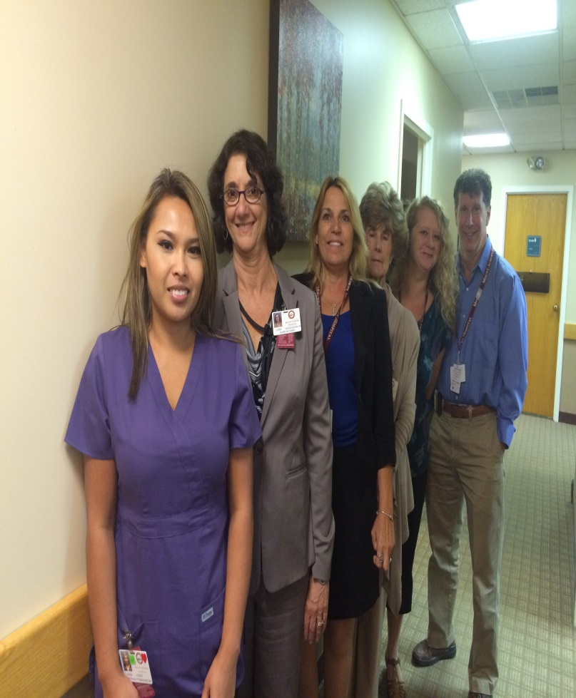
Practice Improvement Team
Erika Anderson, Referral Manager
Danaisa Brown, Medical Assistant
Andrew Cutler, Medical Director, Physician Champion
Sandra De Francisco, Practice Manager
Robert Kelleher, Primary Care Provider
Lora-Gross-Kostka, RN,BSN, Manager Ambulatory Risk/Patient Safety Advisor
Anna Lourn, Medical Assistant
Judith McGrath, Medical Secretary

Slide 3
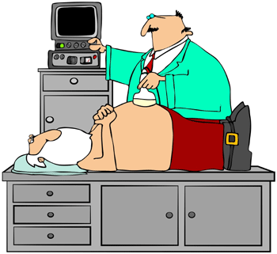
What Did We Work On?
The PCP’s List – to clarify who our patients are and who needs to be screened
Making a list and checking it twice

Slide 4

Using the MFI Framework
100% of eligible patients will have a documented conversation with PCP that results in:
  Colonoscopy
  FIT Test
  Documented refusal and will be asked again
Total number of patients needing screening will drop
PDSA =
Developed by: Associates in Process Improvement

Slide 5
Where are we in our Process
Insurance Reports
Registry Reports
Verification of PCP
Outreach 3x within 90 days (Telephone and letters to engage new and re-engage established patients)
Dismiss deceased or last seen >3yrs that did not re-engage (certified letter as necessary)

Slide 6
Continuous Improvement
Verify Patient List

Slide 7
Examples of Saving Time and Patient Outcomes
Patients repeat requesting FIT test
More accurate registry reports
The outreach letter and blast emails will automatically populate in the patients chart and will not need to be scanned
A “Booking” sheet is used by the Medical Assistant along with creating the order to track patients who agree to a colonoscopy
A Specialist “Access” sheet is used to assist with scheduling

Slide 8
GI Booking Sheet
Primary Care Provider: |  |  | MAMA Fax Number: 617-926-7053
Medical Record Number | Last Name | First Name | DOB | Patient Preference | Telephone Number | Appointment Date & Time | Provider | Direct to Procedure
SPECIALIST ACCESS GRID
Provider: |  |  |  | Specialties:
Contact Person:
Telephone: |  |  |  | Fax:
Address:
Language(s)
Hours |  | Monday | Tuesday | Wednesday | Thursday | Friday
Office | am
 | pm
Procedure | am
 | pm
PATIENT INSURANCE INFORMATION

Slide 9
How this Improves Patient Safety
Resulting in additional time and more efficient outreach to the appropriate patients requiring preventative screenings
Access sheet is used as a guide to book appointments to patients preference and needs
Having the specialist schedule the patient directly will decrease and improve patients compliance
Decreased number of No Shows and Cancellations which will increase GI access for more timely scheduling for all Mount Auburn Hospital patients

Slide 10
Pearls of Wisdom to Share
What I wish someone had told us in the beginning
  Empanelment is Key: We MUST know who the patients are
Biggest Surprises
  Registry reports are unreliable
  Providers embraced “Process Improvement”
  Staff engagement and commitment is rewarding
How to use MFI to tackle other improvement ideas
  “Been there, Done that” – becomes a standardized process

